Slide 1
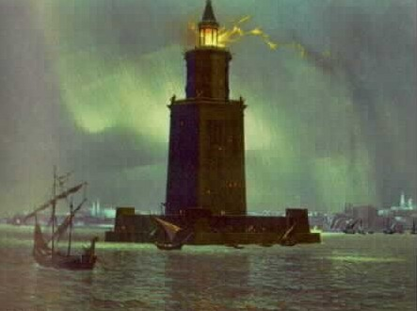
Ancient Greek Learning

Slide 2
Greek Philosophy
Greek Philosophers goal was to pursue wisdom
Philosophy came from the Greek words meaning “love of wisdom.”
The Greeks asked themselves – how do we know what is real? How can we determine what is true?
They believed they could answer these questions by using the human power of reason

Slide 3
Logic
To increase their thinking power, the Greeks developed a system of reasoning known as logic
Logic involves a step by step method of thinking through a problem or question

Slide 4
Socrates
Socrates was an Athenian Philosopher
He wandered around Athens drawing people into conversations
In these discussions, Socrates asked questions after question to force his listener to think more clearly
This method of teaching is called the Socratic Method

Slide 5
Socrates Cont.
Socrates’s discussions challenged traditional beliefs
They got him into trouble with the leaders of Athens
They charged him with corrupting the youth
In the trial Socrates defended himself
He was found guilty and sentenced to death in 399 B.C.

Slide 6
Plato
Plato was a student of Socrates
He recorded his teachers ideas
He founded a school of Philosophy called the Academy
Academy means a school of higher learning

Slide 7
Aristotle
Aristotle was a student of Plato
Later he set up his own school
Aristotle sought knowledge through observation
He analyzed data about everything
His thinking has influenced many scholars today

Slide 8
History
The Greeks search for wisdom led them to study the past
The Greek writer Herodotus is often called “the father of history”
In his master work, “The Histories” he investigates the causes of conflict between the Greeks and the Persians

Slide 9
Politics
Greek thinkers discussed politics and government
Plato wrote a book called “The Republic”
He thought the ideal city-state would be run by philosopher-kings, who had the wisdom to make right decisions
Such leaders would not be elected by the people

Slide 10
Politics Cont.
Aristotle wrote a book about government called “politics”
He compared the existing governments of the day
He argued that the best government would be balance and avoid extremes
He believed that citizens needed to participate in government to be happy

Slide 11
Science
Some Greeks began to look for natural causes for earthly events
The first Greek scientists observed nature
They formed hypotheses, or logical guesses to explain their observations

Slide 12
Natural Sciences
Greek Philosophers began the study of nature
They believed natural laws governed the universe
A philosopher names Thales of Miletus asked questions like – how big is the earth? What holds it in place?

Slide 13
Natural Sciences Cont.
They were not always right
Thales believed that all things were made of water
But he did inspire others to think with logic
He inspired Democritus who said that the universe was made of tiny particles that could not be split
He called them atoms

Slide 14
Technology
The Greeks used their skills to develop sophisticates technology
They invented water clocks and water mills
They used steam power to operate mechanical statues and gadgets

Slide 15
Mathematics
The Greeks discovered many concepts in mathematics
Pythagoras thought numbers were the key to understanding the universe
He developed “square numbers
Students of geometry still learn his theorem today
A theorem is a statement in mathematics that can be proved true

Slide 16
Medicine
The Greeks made important contributions in Medicine
Greek doctors looked for natural causes of illnesses instead of blaming them on the gods
Their success brought them patients through out the ancient world
Greek doctors practiced surgery and dentistry

Slide 17
Hippocrates
Hippocrates became the best known Greek doctor
He wrote many medical books and ran a school that trained new doctors
He taught his students to diagnose patients by asking them questions and making observations so they could learn their symptoms
He also had his students swear an oath to use their knowledge in ethical ways
The Hippocratic oath is still used today

Slide 18
Greeks and Egyptians
The city of Alexandria in Egypt became a center for the study of medicine
The Greeks benefited from the knowledge of the Egyptians
They began to study Human anatomy
They discovered the brain was the center for thought and that the pulse sent blood through the arteries

Slide 19
The Library of Alexandria
When Alexander went conquered new lands, He brought his Greek culture with him
He founded the city of Alexandria in Egypt
The city built a great library
Their goal was to acquire a copy of every book in the world
The collection grew to about 500,000 book rolls or scrolls

Slide 20
City of Scholars
Alexandria attracted some of the most important scholars in history
Scholars translated the Hebrew bible into Greek, and wrote books about math and science

Slide 21
Greek Culture Spreads
Greek culture spread through Alexander's conquest
In Italy, Greek culture would influence a new growing civilizations
The Romans

