Slide 1
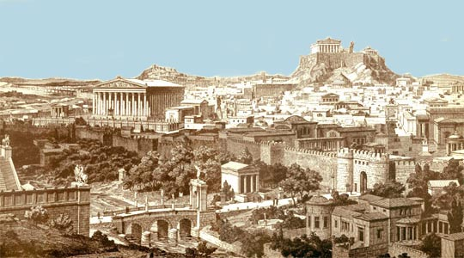
Athens

Slide 2
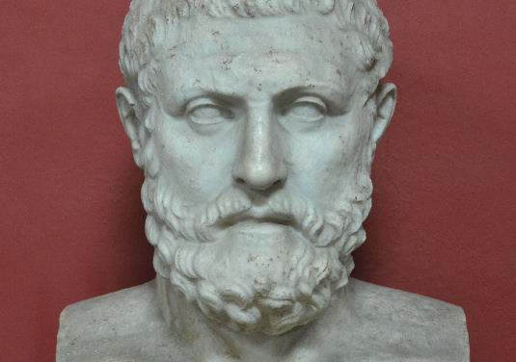
Ancient Greek Society
Free Citizens
1. Aristocracy
2. Small Farmers
3. Tenant Farmers
Free Non- Citizens
4. Women and children born of Citizens
5. Resident Aliens
Not Free People
6. Slaves

Slide 3
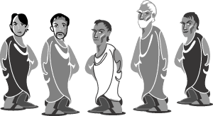
Before Democracy
Many Greek city-states used a type of government called an oligarchy
In an oligarchy, political power is held by a small group of people
The members of the oligarchy were those of the aristocracy

Slide 4
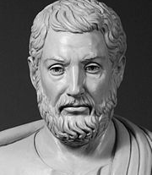
Tyranny
Then the first tyrants, or strong leaders emerged to champion the interests of the citizens
Tyrannies are governments run by a single strong ruler
They were usually members of the Aristocracy
By promising land and other benefits to the poor, a tyrant won popular support
Many tyrants would not fulfill their promises. Many ruled harshly.

Slide 5
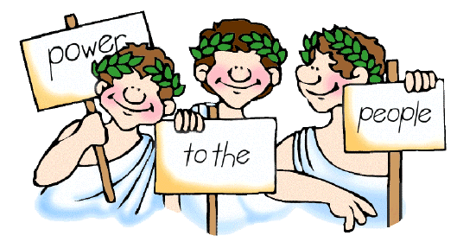
Power of the People
Some city-states, led by Athens example, moved toward rule by the many
The Greeks called this form of government a democracy, which means “rule by the people”

Slide 6
The Beginnings of Democracy
Democracy slowly formed in Athens over a 150 year period
Leaders continued to make reforms, or changes to the government system, to make it more equal for all people
Examples include: expanded the requirements of those who can vote and paying citizens for participating in civic duties, like jury service
The Athenians were proud of what they gad achieved
“When in question of settling private disputes, everyone is equal before the law. When it is a question of putting one person before another in positions of public responsibility, what counts is not membership in a particular class, but the actual ability which the man possesses.”
~ Pericles

Slide 7
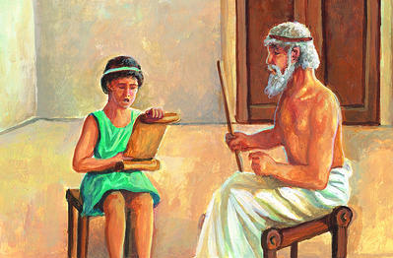
Education for Democracy
Education helped promote the growth of democracy in Athens
The education students received was designed to produce well-rounded citizens who could take part in public life
Some girls could read and write, most education was reserved for boys.

Slide 8
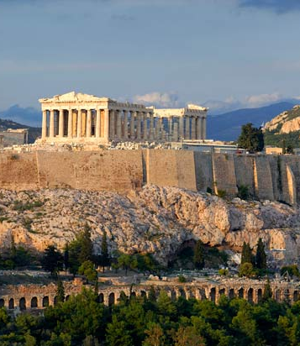
Athenian Democracy
Citizens eventually ran all parts of the government
The most important parts of the government were the assembly, the council and the courts

Slide 9
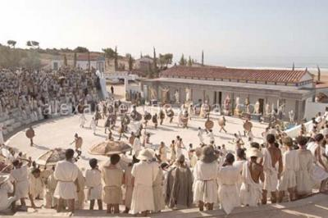
The Assembly
The main political body of Athens was the assembly
All free adult males had the right to attend
Meetings took place 40 times a year
Everyone had the right to speak, from the poorest farmer to the richest aristocrat

Slide 10
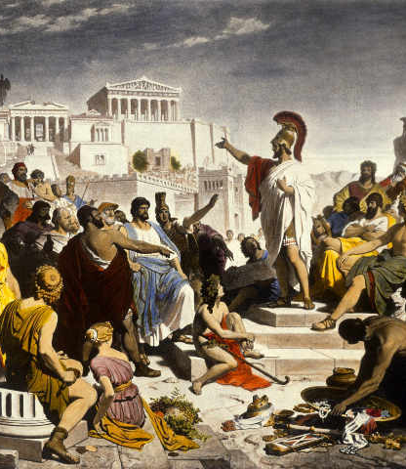
The Boule
The boule was a 500 person council
The council helped decide which issues should be brought before the assembly
Members were chosen by lot, or at random, from among the citizens
Every male citizen had a chance to serve on the council

Slide 11
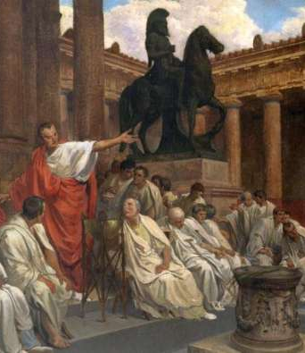
The Courts
The 3rd key component was the court system
Athens had many different courts, each of which decided different types of cases
Juries in Athens were much larger then modern day ones
Several hundred to several thousand might serve on a single jury

Slide 12
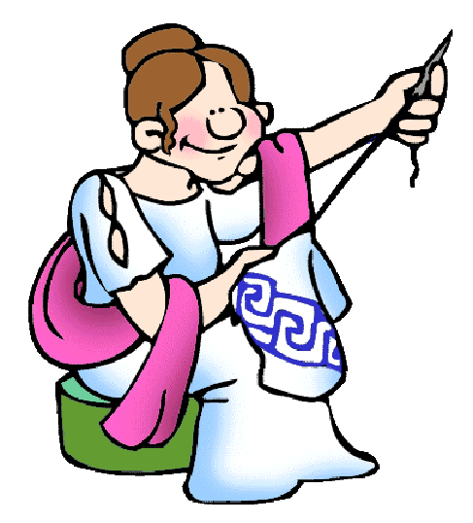
A Limited Democracy
Athens was not completely democratic
Women could not vote or hold office
Foreigners, even those from another Greek city-state, could not be citizens
Slaves had no rights

Slide 13
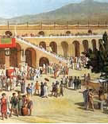
Direct Democracy
Athenians practiced direct democracy
Direct democracy is a system in which citizens participate directly in the decision making process
It worked in Athens, because it had the population of a city-state

Slide 14
Representative Democracy
Most democracies today are representative democracies
Citizens elect others to represent them in government
These representatives make decisions and pass laws on behalf of the people.

