Slide 1
The Han Dynasty

Slide 2
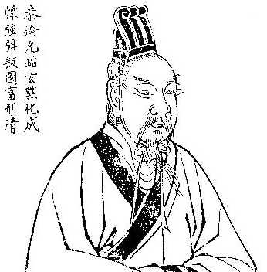
The Han Dynasty
In 106 B.C. a rebel general named Liu Bang gained control of China
He founded the Han dynasty
The Han ruled China for 400 years
Today, the largest group in China still call themselves the Han

Slide 3
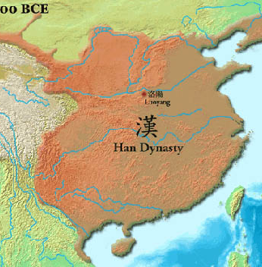
Reuniting China
The first Han emperor came from a poor family
His success was due to his ability to surround himself with strong advisors
He consulted a Confusion scholar who pointed out that the Qin lost power because of their harsh policies
The emperor encouraged learning, lowered taxes and ended hard Qin policies

Slide 4
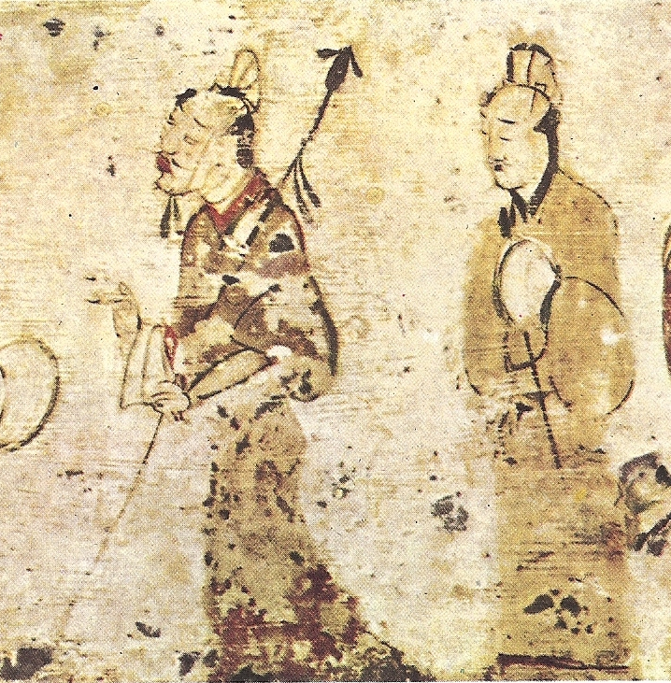
Han Government
The Han emperors created a strong government to keep national unity
The Han government was organized like a pyramid with the emperor on top.
At each level, government officials took orders from those above them and gave orders to those below them

Slide 5
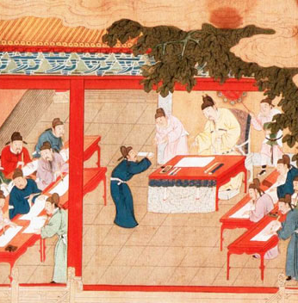
Civil Service
The strength of the Han government was in the civil service
A civil service is a system of government employees selected for their skills and knowledge
With in two years of Han rule, the civil service grew to more then 130,000 officials

Slide 6
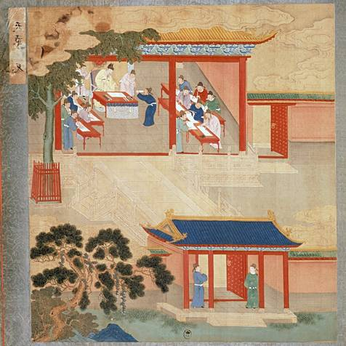
Civil Service Cont.
Positions were not hereditary
Officials were appointed to positions
Emperor Wudi created exams to find talented people of the civil service
Han officials enjoyed high salaries and a life of comfort and influence

Slide 7
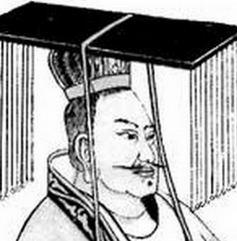
The Journey West
The Chinese sent officials west into Central Asia
They were looking for new allies to help defeat a group of nomads
Emperor Wudi sent more officials and his army to help support trade
Merchants could now trade with Central Asia with out any fear of being attacked

Slide 8
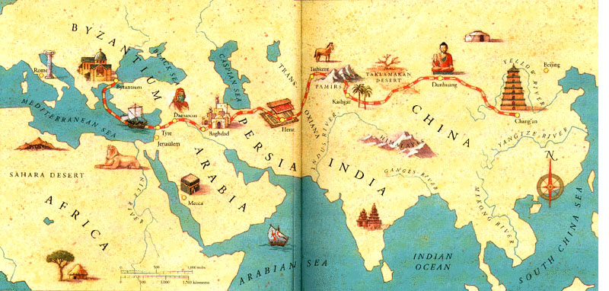
The Silk Road
The trade created the “silk road” or a network of trade connecting China to Central and Southwest Asia
Merchants made a lot of money on the Silk Road, but it was also a path for new ideas

Slide 9
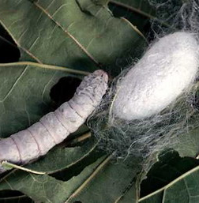
Silk Road Cont.
The name comes from China’s most important export: silk
Silk is made from the cocoon of a caterpillar called the silk worm
Only the Chinese knew how to make silk
They guarded the secret closely. It was illegal to export silk worms

Slide 10
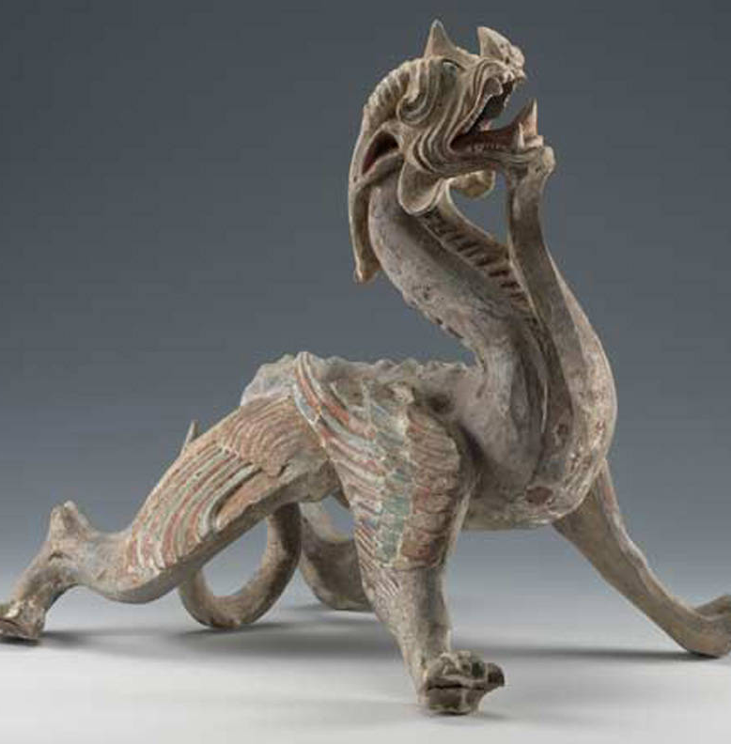
Silk Road Cont.
The Chinese exchanged silk and other luxury goods for a wide range of other products
The silk road also enriched Chinese Cuisine
Buddhism also entered China at this time
Over time it became very popular and influential in China

