Slide 1
The Division of the Christian Church

Slide 2
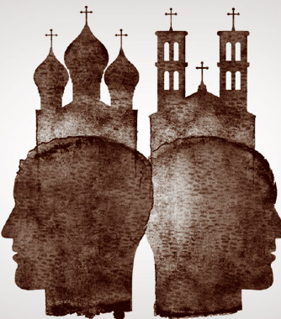
Religious Differences
By the late 300s, Christianity was the official religion of the Roman empire
As the faith grew, Christians began to argue about the core beliefs of the faith
These arguments eventually split Christianity into two churches
Roman Catholic and Eastern Orthodox

Slide 3
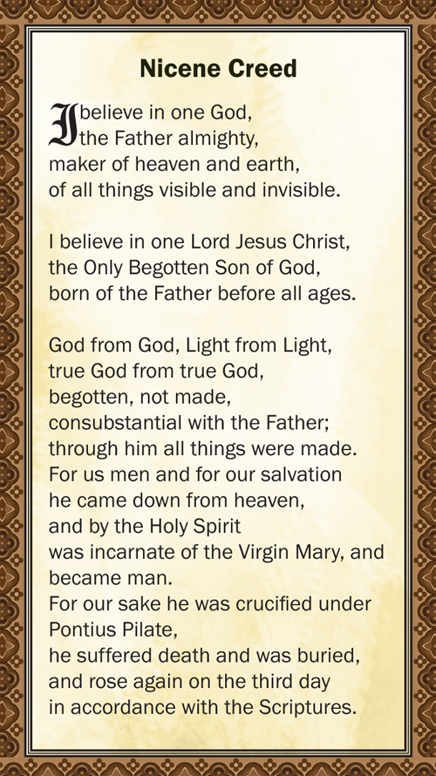
The Nicene Creed
Early Christians argued over who Jesus was
Some argued he was fully human
Others believed he was fully divine, or that he was both
In 325, Constantine called a council of bishops in the city of Nicaea
The early church leaders created a statement of beliefs, or a creed, called the Nicene creed
It stated Jesus was both human and divine

Slide 4
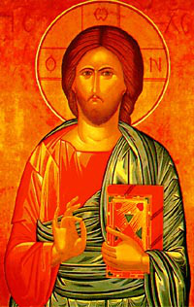
Icons
Christians also argued over the use of icons
An Icon is a holy image, usually a portrait of a saint or Jesus
Many Christians displayed icons in their homes and churches
For them, honoring an icon was a pathway to God
But to others, praying to icons seemed like worshipping objects, which is forbidden in the Bible

Slide 5
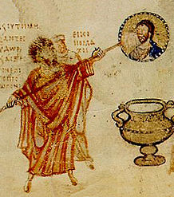
Iconoclasts
In the 700s several Byzantine emperor tried to stop icon use
People who opposed icons were called iconoclasts or “image-breakers.”
They went into churches and smashed icons
Eventually emperors took control who opposed the iconoclast
Today, Icons are an important part of worship in Eastern Orthodox churches

Slide 6
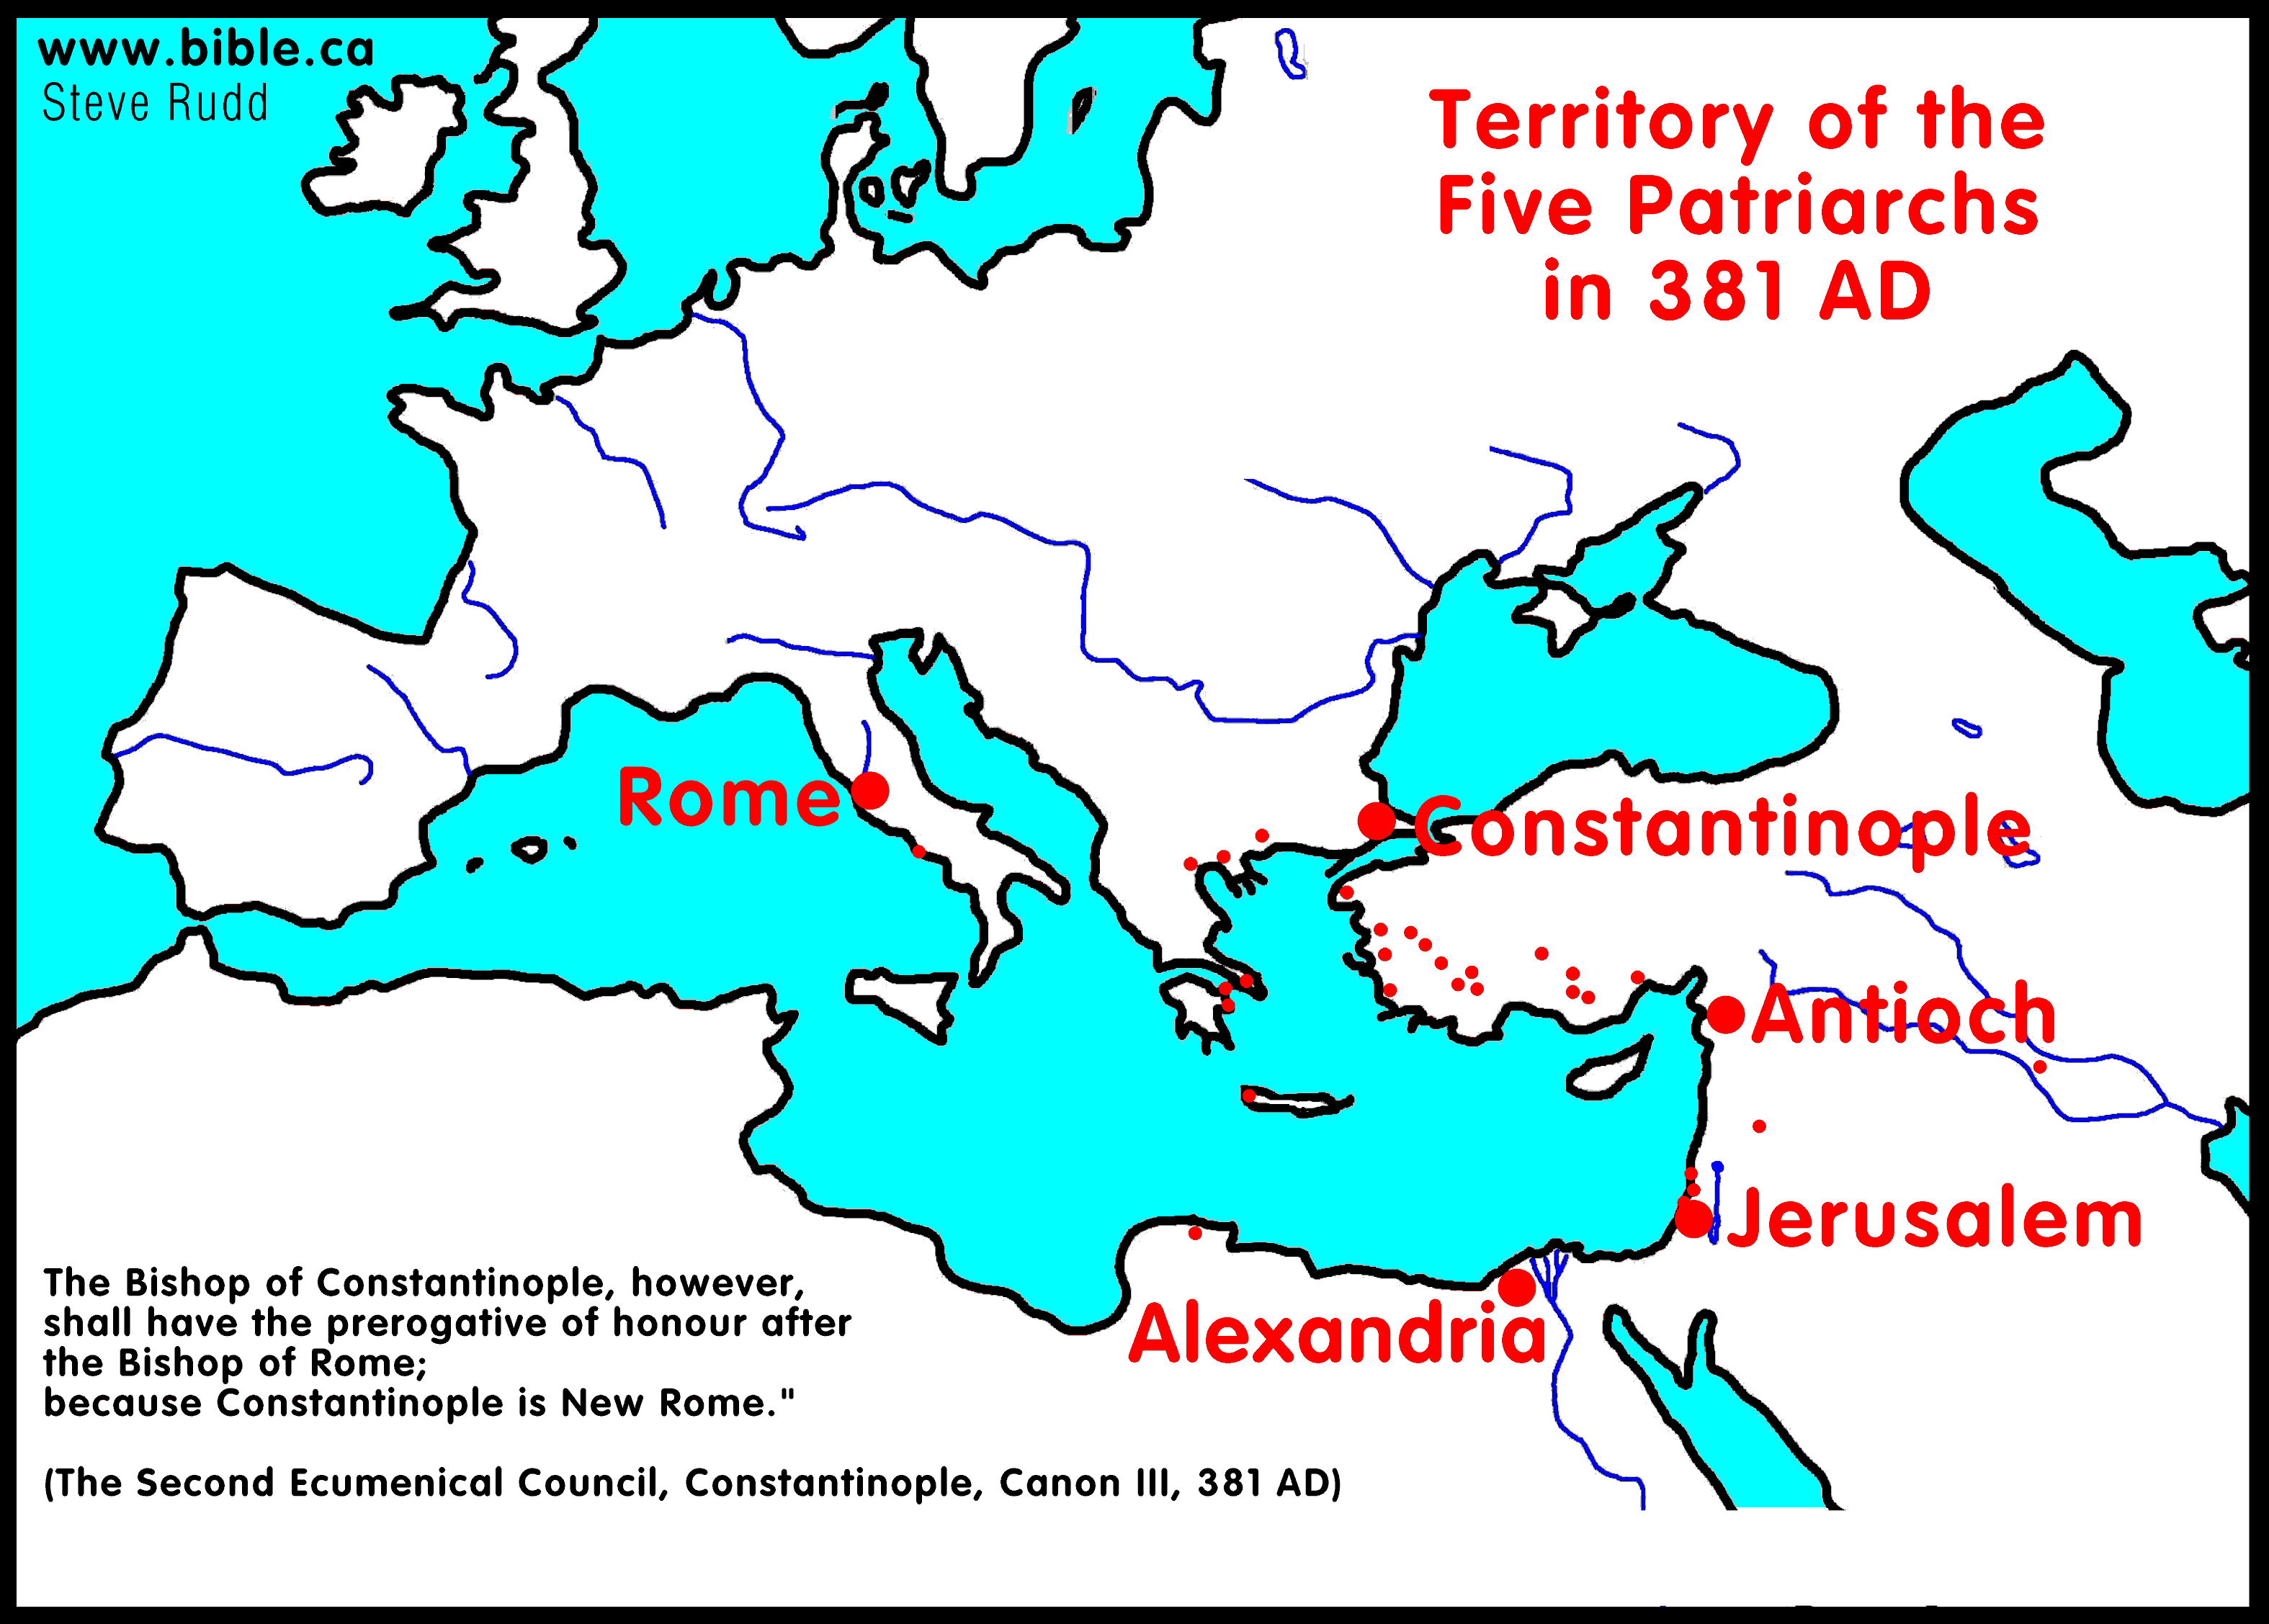
Church Organization
The most important Christian leaders were called bishops
Early on, each church was led by its own bishop
Later, a single bishop took charge of all the churches in a city
Eventually bishops gained authority over all the churches in a region
The bishops in the 5 most important cities, Constantinople, Rome, Alexandria, Antioch and Jerusalem, were known as patriarchs

Slide 7
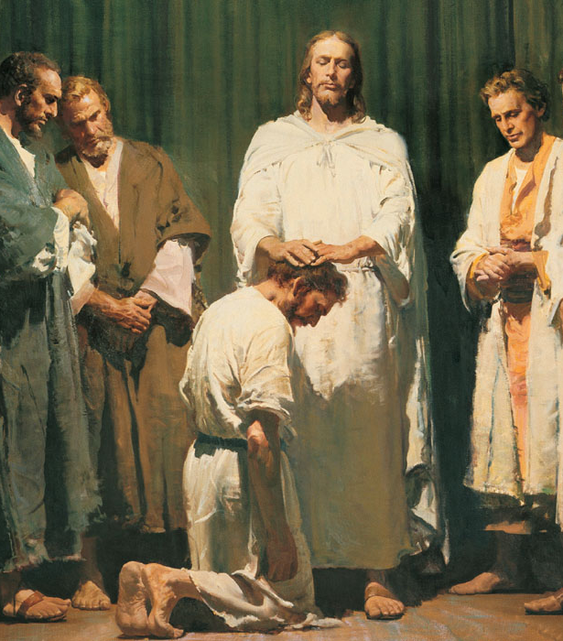
The Power of Bishops
The bishops authority was based on a tradition known as apostolic succession
Jesus gave authority of his church to the original apostles
They based this authority down to each generation of bishops

Slide 8
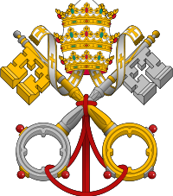
The Pope
At first, the five patriarchs were equal in authority
Over time, the bishop of Rome claimed authority over all Christians
He began to be called the pope, which means father, or head of the Church

Slide 9
The Power of The Pope
The popes based their claim on the idea that they were the successors to the apostle Peter
They argued that Jesus made Peter the head of the church
Peter had traveled to Rome to become its first bishop
After his death, his authority as head of the Church should be passed on to the bishops who followed him
Eastern patriarchs and Byzantine emperors rejected this view
It would take away their own power over their own churches
“You are Peter and on the rock I will build my church… I will give you the keys of the Kingdom of heaven, and whatever you bind on earth shall be bound in heaven.”
~Matthew 16:18-19

Slide 10
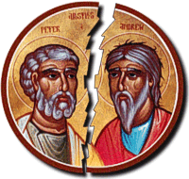
The Great Schism
Over time, the differences between the Eastern and Western churches grew
Two different religions developed
In 1054, these two traditions formally split
The split is known as The Great Schism
Schism is Greek meaning split or division

Slide 11
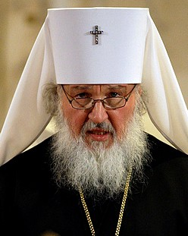
Eastern Orthodox Church
The Eastern branch of the church came to be called the Eastern Orthodox Church
Orthodox means following established beliefs
The Byzantine emperor was the head of the church
Patriarchs handled the day-to-day affairs
They were all equals, through the Patriarch of Constantinople is considered first among equals
The Emperor had the power to remove a patriarch if he chose to

Slide 12
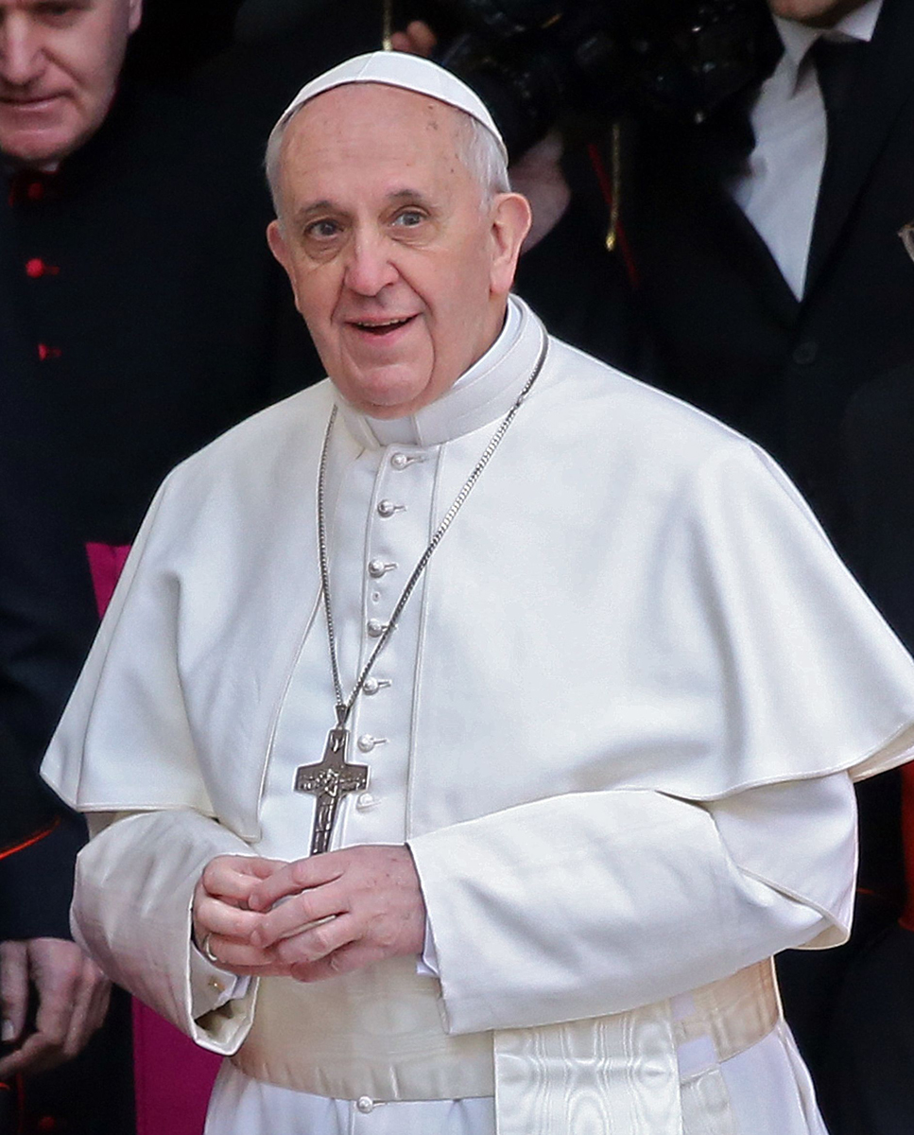
The Roman Catholic Church
The Western tradition became known as the Roman Catholic Church
Roman because it was based in Rome
Catholic means universal, or concerned with all people
Greatly shaped the culture of Western Europe
The pope is the head of the Church
He did not take orders from any leaders, including the Byzantine emperor
This was the most important issue dividing the two churches

Slide 13
Different Traditions
Eastern Orthodox
Roman Catholic
Official language was Greek
Priests are allowed to get married
Highest church official is the Patriarch of Constantinople
Byzantine emperor headed the Church
Official language was Latin
Priests are not allowed to get married
Highest Church official is the Pope
The pope headed the Church

Slide 14
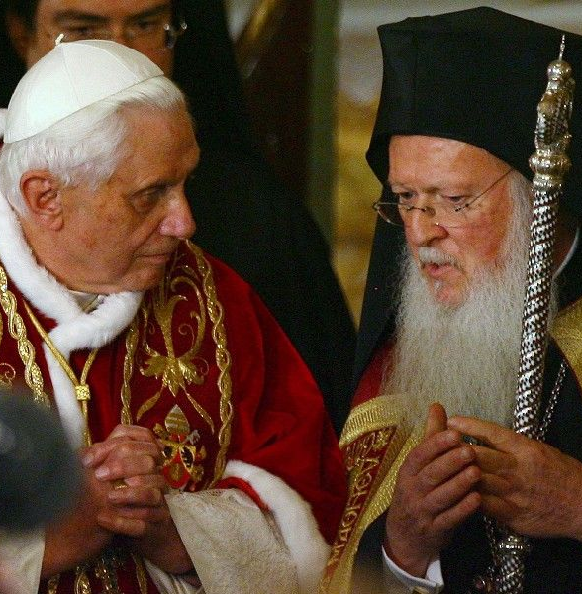
Easter Orthodox Today
Today there is no Byzantine Emperor
Orthodox Churches in different countries are led by their own patriarchs
They still do not recognize the popes power
Relations between the churches have improved, but the division remains

