Slide 1
The Gupta Empire

Slide 2
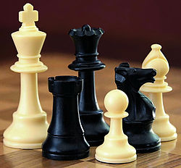
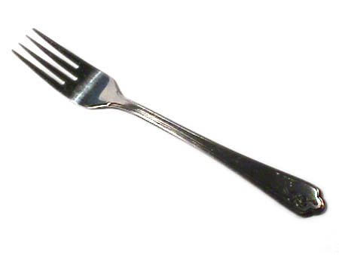
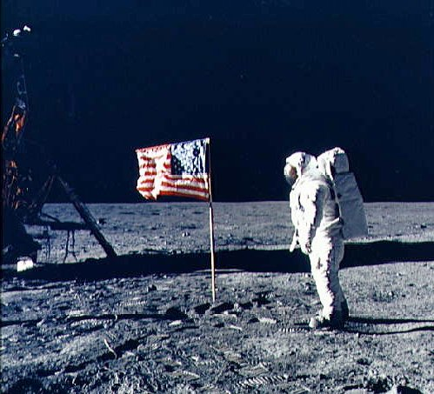

Slide 3
A New Empire
About 500 years after the fall of the Maurya, The Gupta dynasty united northern India
Chandra Gupta I gained control of a kingdom in the Ganges Basin
He quickly expanded his territory across the Basin

Slide 4
Exterminator of Kings
His son, Samudra, conquered most of the remaining Kingdoms in the North
Under his son, Chandra Gupta II, the empire reached it greatest size
The, like Ashoka, he tried to bring peace ad prosperity to India

Slide 5
Gupta Government
Unlike the Mauryas, the Guptas did not try to rule their entire empire directly
They left most decisions in the hands of local leaders.
Village and city councils made decisions at the local level
The people of the Gupta empire were subjects, with a duty to obey
but were also citizens, or a status with political rights and obligations

Slide 6
Culture
Around this time period, artists made great achievements
This period still influences India and the world today
Much of the art was religious
Buddhism was important, but the Guptas favored Hinduism

Slide 7
Literature
The greatest writer of the time was the Poet Kalidasa
He wrote plays and poetry in the ancient language of Sanskrit
A popular form of literature was the fable
A fable is a short story with a moral or a lesson at the end

Slide 8
Music, Dance and Entertainment
Dancers created works based on Hindu literature
Musicians played stringed instruments and drums
Some forms of Indians drama combined stories, dance and music
The game of chess was invented
The first pieces represented the Indian army

Slide 9
Architecture
Buddhists and Hindus made many temples at this time
Stonecutters carved huge temples from one large rock
Architects built impressive free standing temples and monasteries

Slide 10
The Decimal System
One major development was the concept of zero as a number and as a numeral
A numeral is a symbol used to represent a number
Their greatest achievement was the decimal system
A counting system based on units of 10
Together these advances were the basis for Arabic numerals, the numbers we use today

Slide 11
A New World of Mathematics
Combining a decimal system with the number zero transformed mathematics
Operations, like multiplication were very difficult under other number systems
Their number system opened the door for advances in math, like algebra

Slide 12
Math Cont.
Aryabhata was an important Indian mathematician and astronomer
He wrote a book covering arithmetic, algebra and trigonometry
Hundreds of years later, Europeans used his book to learn how to find an area of a triangle or the volume of spheres

Slide 13
Astronomy
Aryabhata was the first astronomer to state that the Earth rotates or spins to create day and night
He discovered that eclipses were caused by the motion of the earth and moon
He discovered that the moon shines because it reflects sunlight

Slide 14
Medicine
Indian doctors write medical textbooks that describe more than a thousand diseases.
They explain how to make hundreds of medicines from plants, animal parts and minerals
They explain how to treat problems such as broken bones or blindness

Slide 15
Metallurgy
Gutpa artists made progress in metallurgy
The science that deals with extracting metals from ore to create useful things
The iron pillar of Delhi is a 23 foot high column made from a single piece of Iron.
It has stood outside for more than 1,500 years without turning to rust

